Slide 1
SWIGGY ANALYSIS
PREETHI | MBT12

Slide 2
1)Top 10 Areas with Most Restaurants
1)Chembur
2)Kothrud
3)Andheri East
4)Navrangpura
5)Indiranagar
6)Kurla
7)Bidhannagar
8)Ashok nagar
9)Banjara Hills
10)Santacuz east
11)Athwa

Slide 3
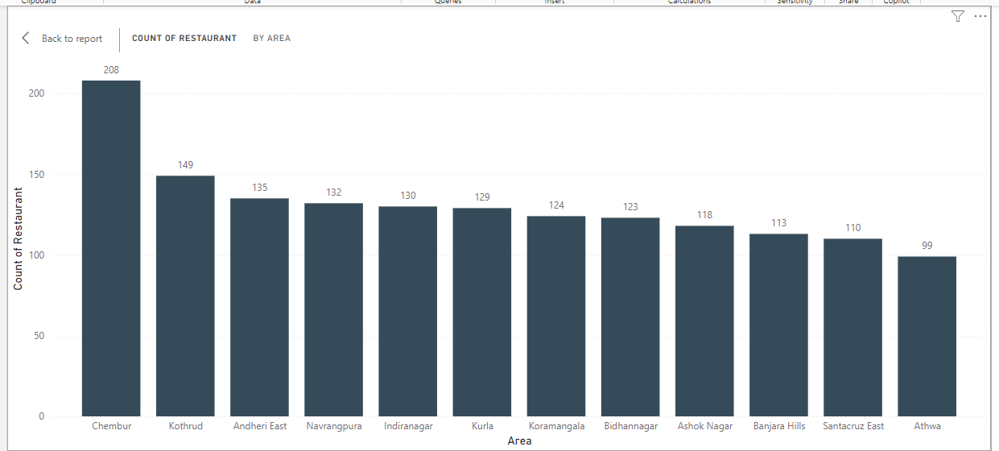
Top 10 Areas with Most Restaurants

Slide 4
2)Most Popular Food Types Served by Swiggy Restaurants in Each City
Most popular food in swiggy based on customer reviews and ratings to gauge popularity.
Rating is mainly based on
Food taste
Delivery time
Price
Most popular food in swiggy and number of city distributing those food
Indian (389)
Chinese (277)
North Indian (246)
Fast food (240)
South Indian (228)

Slide 5
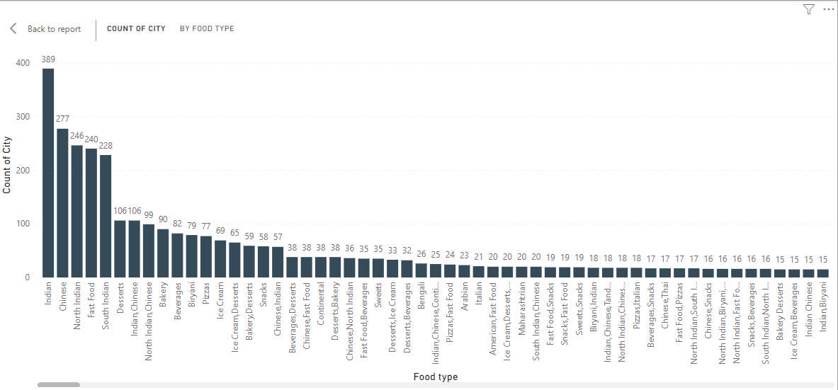
Most Popular Food Types Served by Swiggy Restaurants in Each City

Slide 6
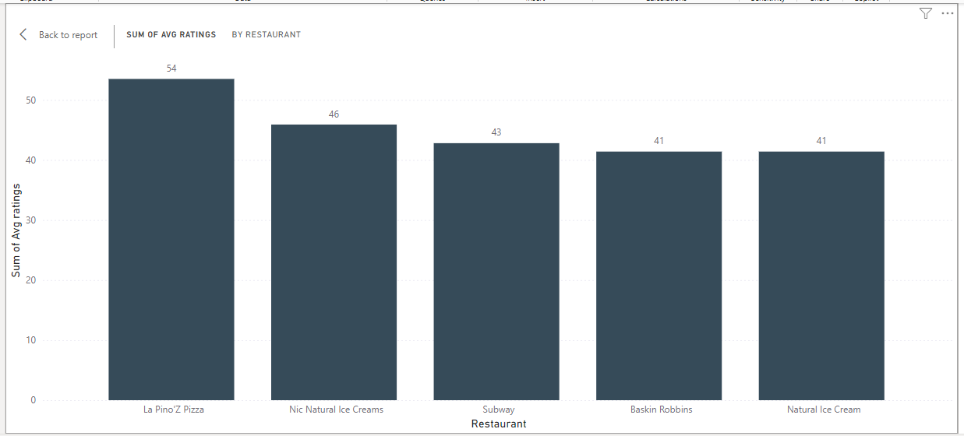
3)Top Rated Swiggy Restaurants (In Percentage)

Slide 7
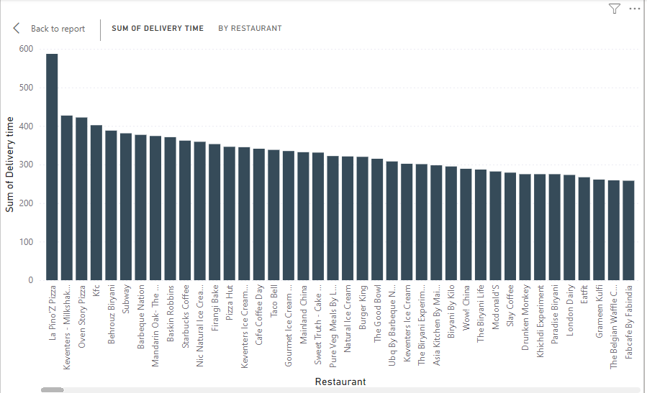
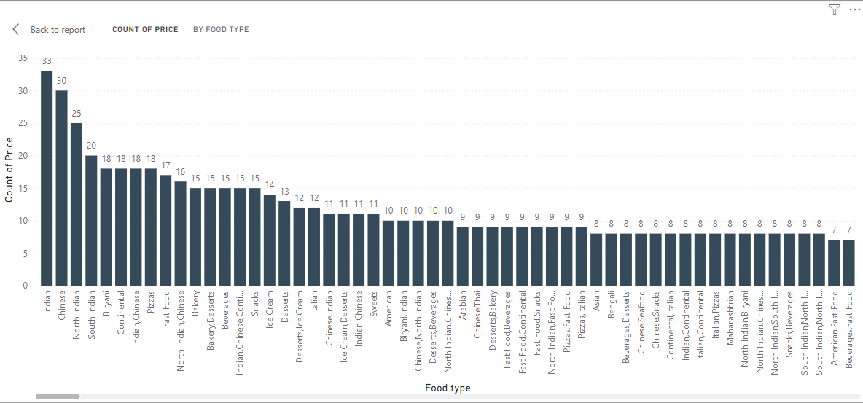
4) Correlation of Factors Affecting Average Rating
Price: Cost of the product or service.
Delivery Time: Time taken for the product to be delivered.
The Average rating affected by Delivery time.
The Average rating affecting by Price

Slide 8
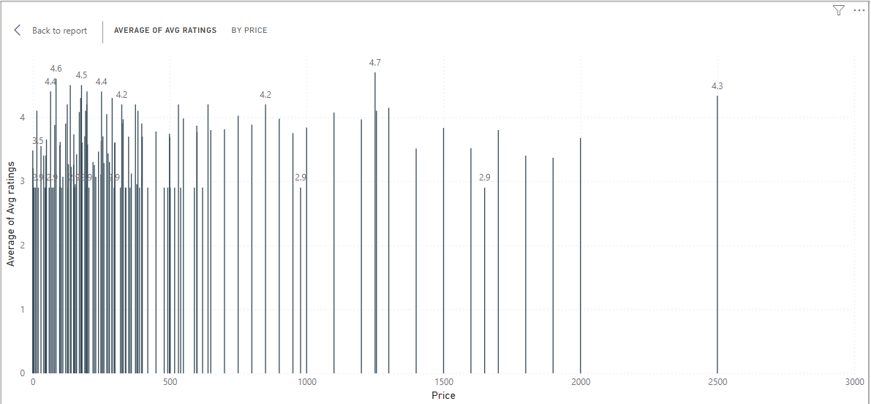
5) Correlation Between Restaurant Price and Average Rating

Slide 9
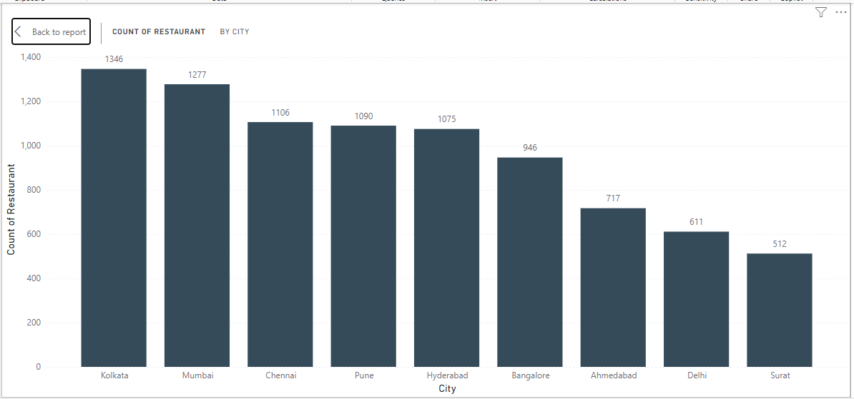
6) City-wise Restaurant Count

Slide 10
7)Price Analysis
Price distribution for each food is different from each restaurant.
It may be because of their taste , quality & some time price increased due to their highest rating.
Some times delivery timing also increase the rating of the store & food item
The sum of high pricing here is Oven story pizza rating, It may distributed in many store and each store it have different price. It have average rating of 35.90
The sum of low pricing here is Pizza Store rating, It may distributed in minimum number store and each store it have different price. . It have average rating of 2.90

Slide 11
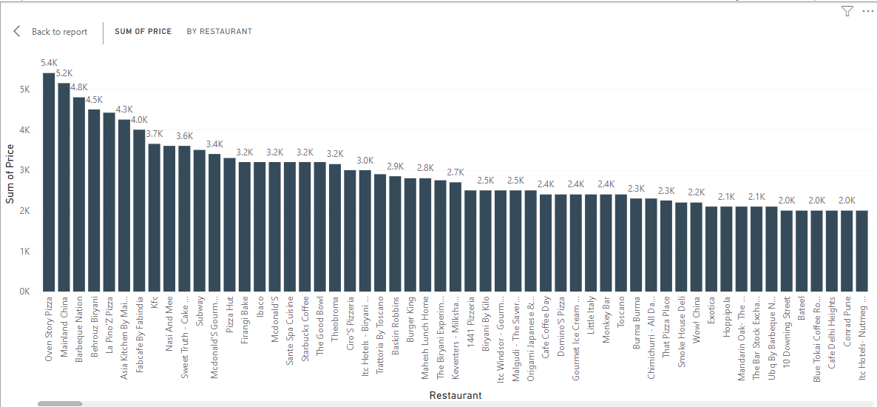
Highest Price

Slide 12
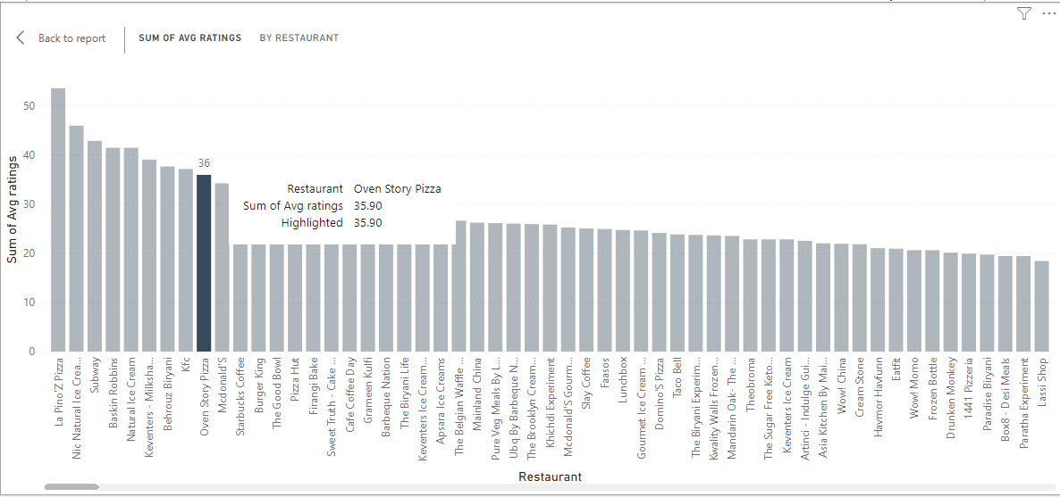
Average rating of Oven story pizza

Slide 13
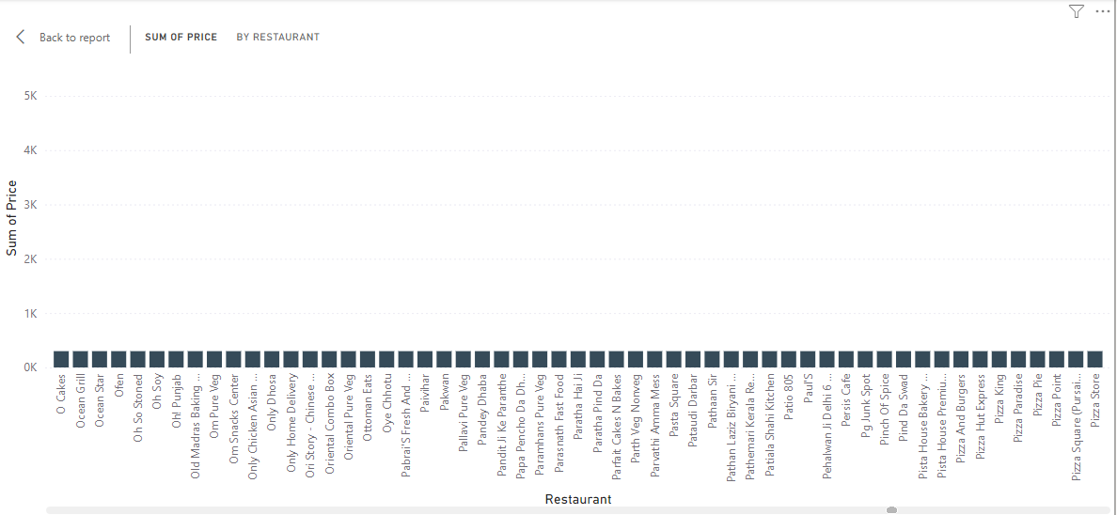
Lowest Price

Slide 14
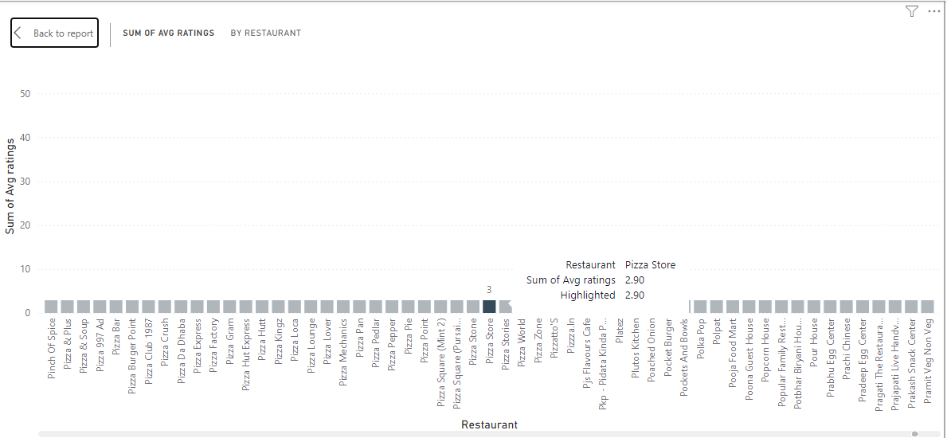
Average rating of pizza store

Slide 15
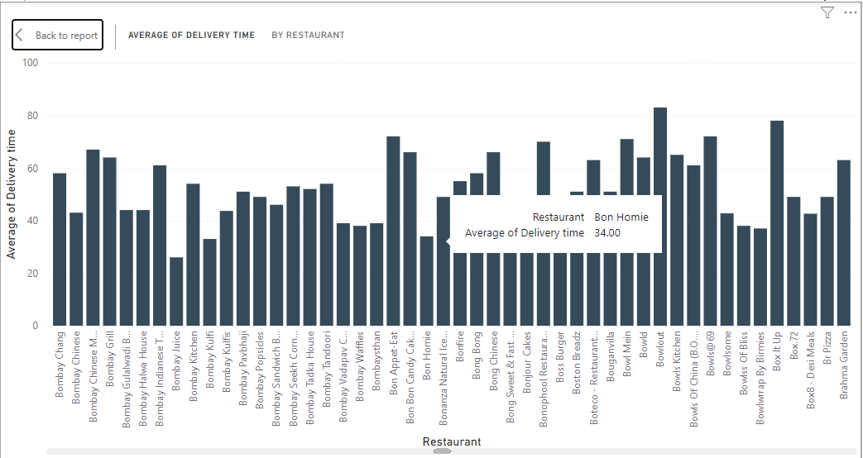
8)Delivery Time Analysis
Lowest delivery time

Slide 16
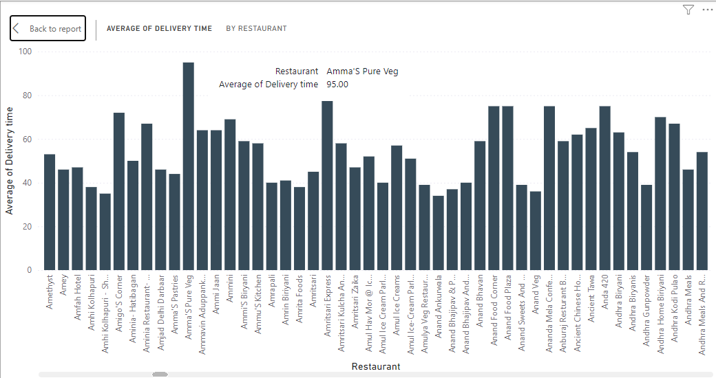
Highest Delivery Time

Slide 17
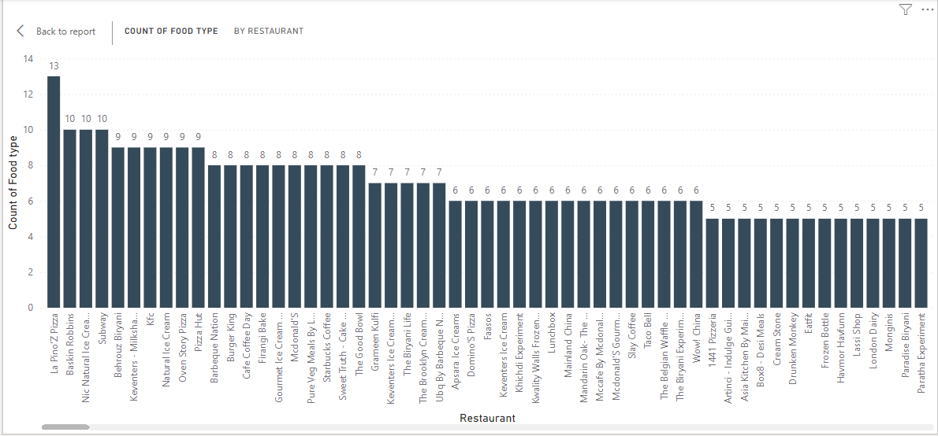
9) Cuisine Analysis

Slide 18
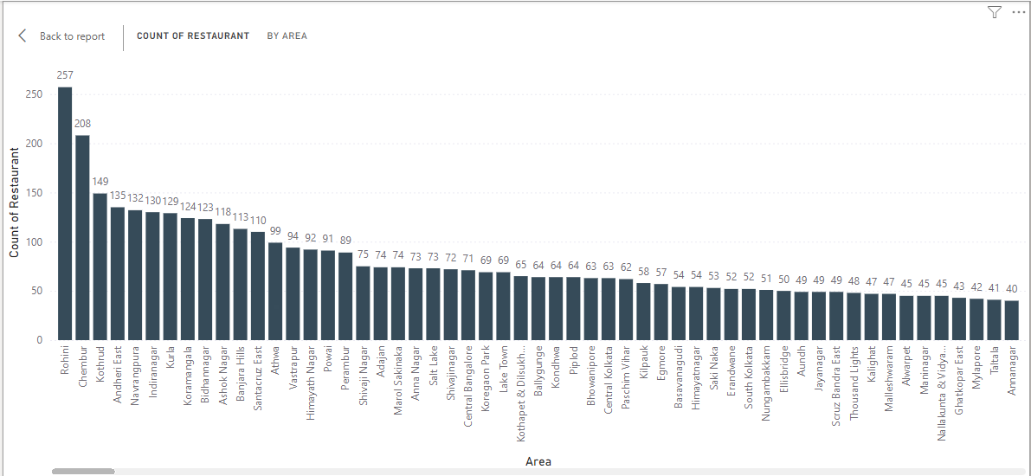
10) Area-wise Restaurant Analysis

Slide 19
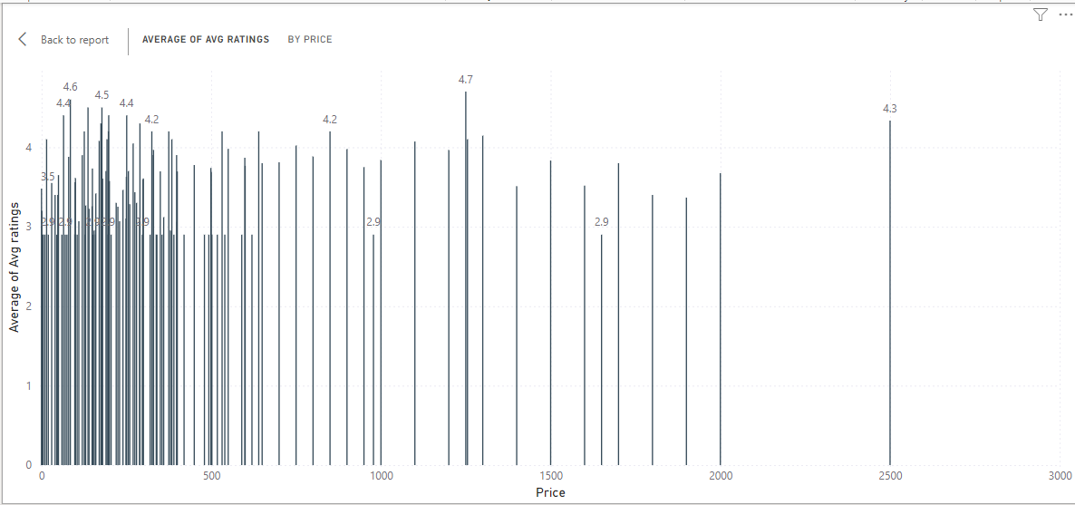
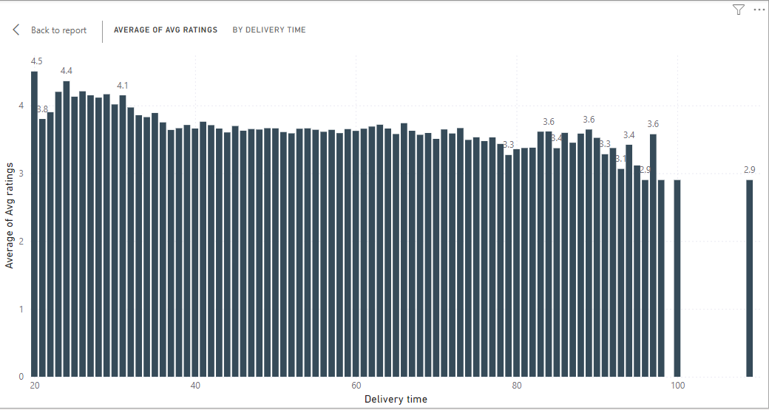
11) Correlation Analysis
Both price & delivery time have big impact on rating.
Food price is determined by food taste , quality & quantity.
Price & avg rating
Delivery time & avg rating

Slide 20
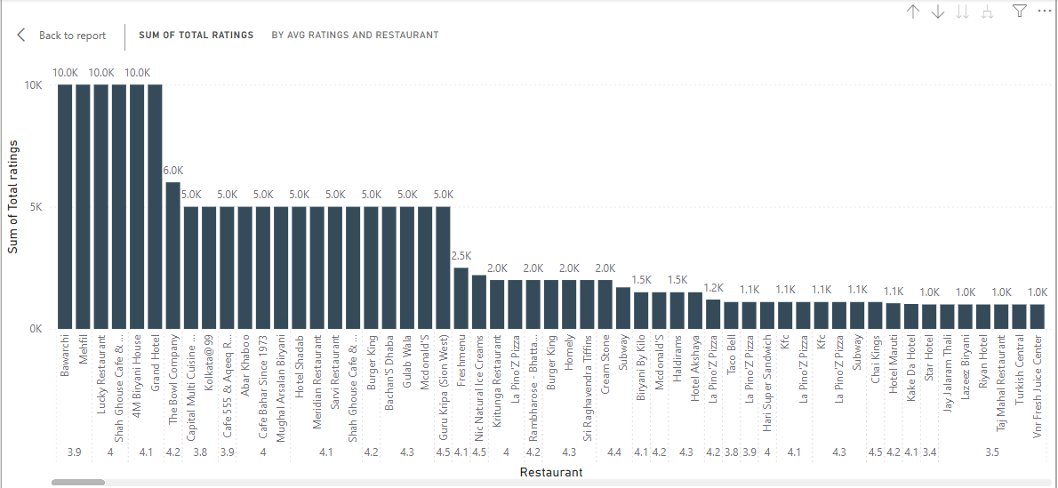
12) Customer Feedback Analysis
Customer feed back in rating includes all the factors such as delivery time, taste, food quality, food quantity &Price.

Slide 21
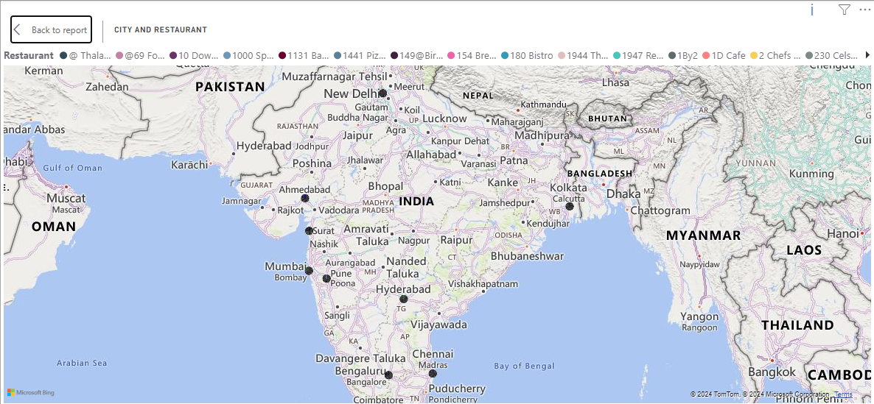
13) Geographical Mapping

Slide 22
14) Business Recommendations
Collaboration with Food Brands and resturants
To offer to cater to health-conscious consumers.
Popular food brands for exclusive menu items.
Offer authentic regional dishes.
Dynamic Pricing
Offer discounts on festival seasons.
Targeted discounts and loyalty rewards for frequent users.
Adjusting price on popular foods to attracts more customers.
Feedback
Encourage customers to leave feedback on their dining experience .
Use this data to improve service and food quality.
Social Media Engagement:
Increase engagement on social media platforms with contests, food photography challenges, and partnerships with influencers.

Slide 23
THANK YOU !

